Slide 1

Foundation PHYSICS
Seminar 7: ELECTRIC CURRENT, RESISTANCE, and CAPACITANCE

Slide 2
Learning outcomes
Students will be able to:
Understand the use of Ohm’s Law which describes the relationship between current, resistance, and voltage; and of Joule’s Law regarding the electric power.
Identify the properties of different types of resistors and capacitors.
Determine the magnitude of capacitance when capacitors are arranged in series or in parallel in an electrical circuit.

Slide 3
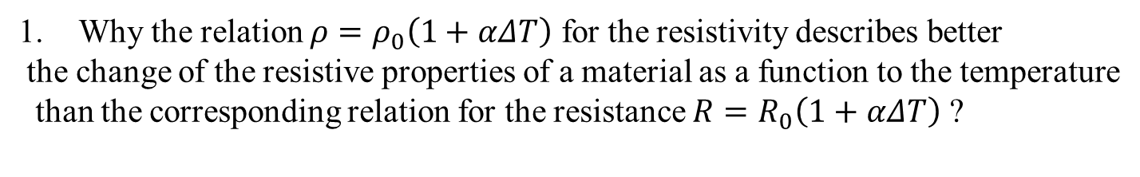
Practice Questions
Why the relation $ρ=ρ_{0}\left(1+αΔT\right)$ for the resistivity describes better
the change of the resistive properties of a material as a function to the temperature
than the corresponding relation for the resistance $R=R_{0}\left(1+αΔT\right)$ ?
Why are parallel circuits preferred in household wiring?

Slide 4
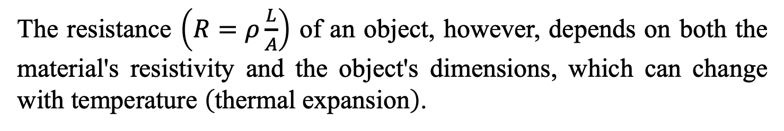

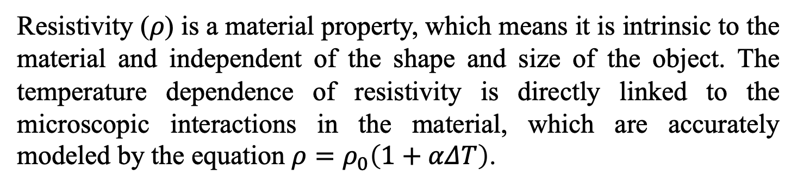
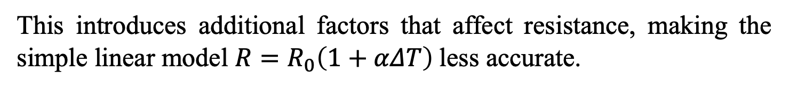
ANSWER: Practice Question 1
Why $ρ=ρ_{0}\left(1+αΔT\right)$ is “better” than $R=R_{0}\left(1+αΔT\right)$ when describing the properties of the material?
Resistivity ($ρ$) is a material property, which means it is intrinsic to the material and independent of the shape and size of the object. The temperature dependence of resistivity is directly linked to the microscopic interactions in the material, which are accurately modeled by the equation $ρ=ρ_{0}\left(1+αΔT\right)$.
The resistance $\left(R=ρ\frac{L}{A}\right)$ of an object, however, depends on both the material's resistivity and the object's dimensions, which can change with temperature $\left(\text{thermal} \text{expansion}\right)$.
This introduces additional factors that affect resistance, making the simple linear model $R=R_{0}\left(1+αΔT\right)$less accurate.

Slide 5
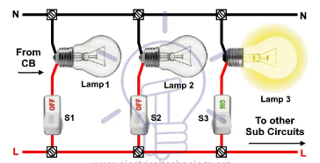
ANSWER: Practice Question 2
Parallel circuits:
Parallel circuits ensure that each appliance operates at the same voltage level and allows them to function independently. This arrangement minimizes the risk of total power outage and enables more uniform distribution of load, enhancing safety and efficiency.

Slide 6
Question 1
Explain how a battery generates an electric current in a closed circuit.
Calculate the current flowing through the circuit if the battery provides a potential of 9 V and the resistance is 18 ohms.
Discuss the effect of increasing the battery voltage on the current.

Slide 7
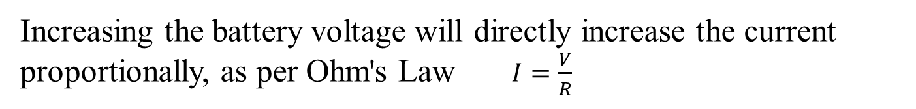
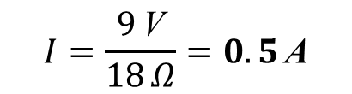
Question 1: ANSWERS
(a) How battery generates electric current:
A battery generates an electric current by converting chemical energy into electrical energy, creating a potential difference between its terminals that causes electrons to flow through a closed circuit.
(b) Calculating the current flowing:
Using Ohm's Law, $I=\frac{V}{R}$, where $V=9$V and $R=18$ $Ω$:
$$I=\frac{9 \text{V}}{18 Ω}=0.5 \text{A}$$
(c) Increasing the battery voltage:
Increasing the battery voltage will directly increase the current proportionally, as per Ohm's Law $I=\frac{V}{R}$

Slide 8
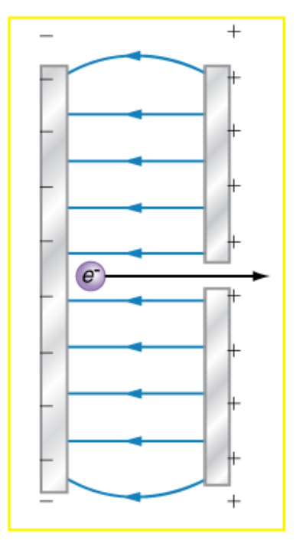
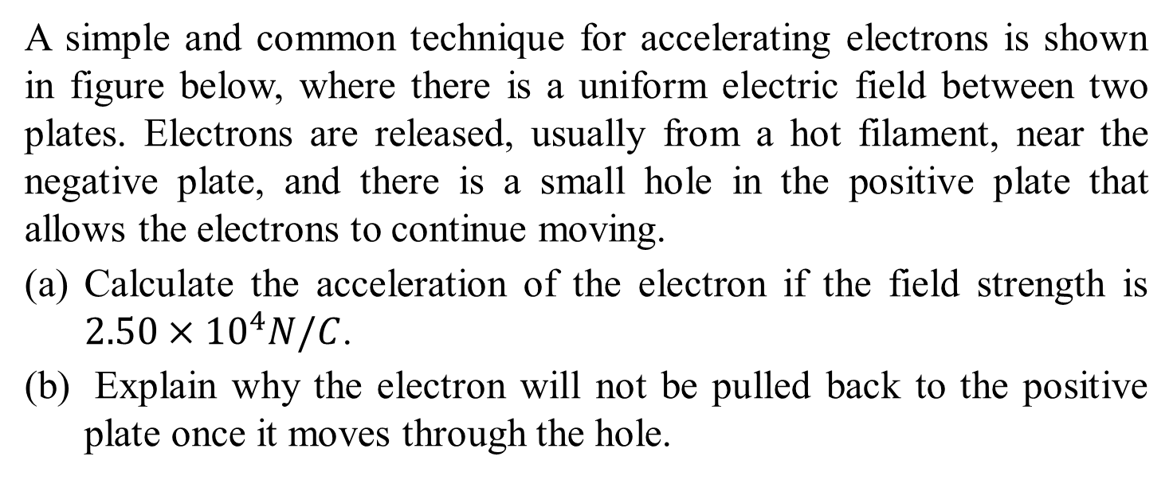
Question 2
A simple and common technique for accelerating electrons is shown in figure below, where there is a uniform electric field between two plates. Electrons are released, usually from a hot filament, near the negative plate, and there is a small hole in the positive plate that allows the electrons to continue moving.
Calculate the acceleration of the electron if the field strength is $2.50×{10}^{4}N/C$.
Explain why the electron will not be pulled back to the positive plate once it moves through the hole.

Slide 9
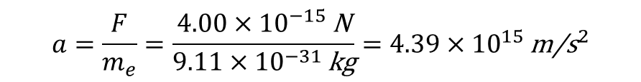
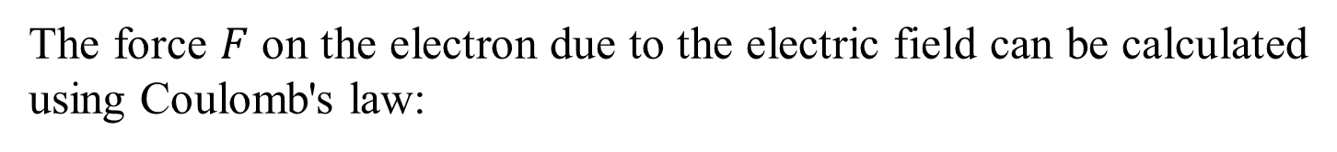

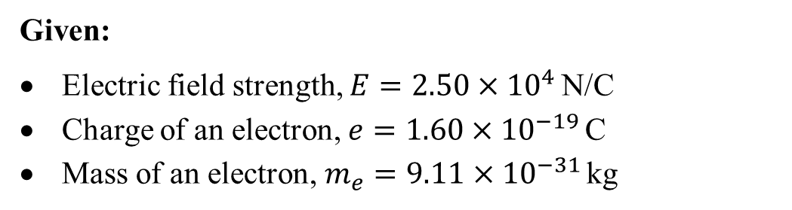

Question 2: ANSWERS
(a) Calculate the acceleration of the electron
Given:
Electric field strength, $E=2.50×{10}^{4}$N/C
Charge of an electron, $e=1.60×{10}^{−19}$C
Mass of an electron, $m_{e}=9.11×{10}^{−31}$kg
The force $F$ on the electron due to the electric field can be calculated using Coulomb's law:
$$F=e×E$$
Substituting the values:
$$F=\left(1.60×{10}^{−19} \text{C}\right)×\left(2.50×{10}^{4} \text{N}\text{/}\text{C}\right)=4.00×{10}^{−15} \text{N}$$
Now, we use Newton's second law to find the acceleration $a$:
$$F=m_{e}×a$$
$$a=\frac{F}{m_{e}}=\frac{4.00×{10}^{−15} \text{N}}{9.11×{10}^{−31} \text{kg}}=4.39×{10}^{15} {\text{m}\text{/}\text{s}}^{2}$$
So, the acceleration of the electron is approximately $4.39×{10}^{15} {m/s}^{2}$.

Slide 10
Question 2: ANSWERS
(b) Explain why the electron will not be pulled back to the positive plate
Even though there is a positive charge on the plate, it does not have a significant effect on the electron once it has exited through the hole, because the electron is already moving at a high speed and is far enough from the plate where the force acting on it becomes negligible. Also, the electric field of a capacitor is strong only between the plates and not outside.
This is why the electron will not be pulled back to the positive plate after it passes through the hole.

Slide 11
Question 3
A small office-building air conditioner operates on 408V AC (RMS value) and consumes 50.0 kW.
What is its effective resistance?
What is the cost of running the air conditioner during a hot summer month when it is on 8.00 h per day for 30 days and electricity costs 0.5 RMB/kW⋅h?

Slide 12
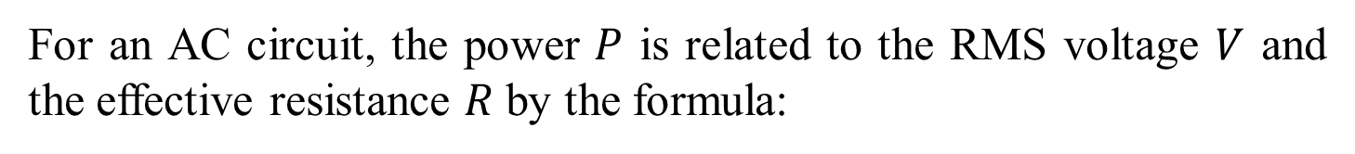
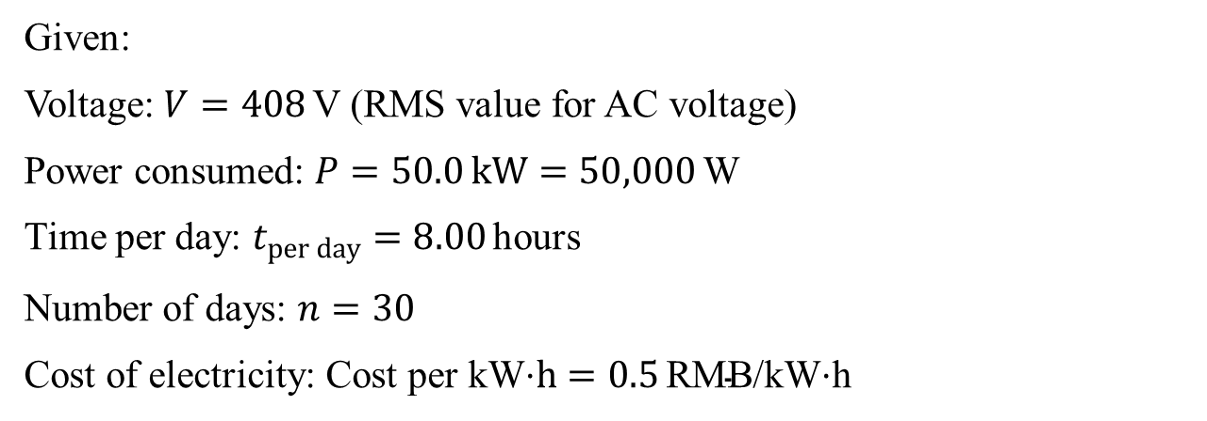

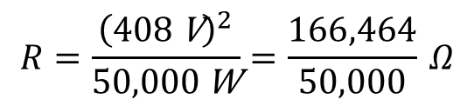
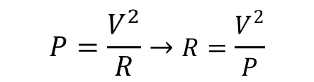
Question 3: ANSWERS
(a) What is its effective resistance?
Given:
Voltage: $V=408$V (RMS value for AC voltage)
Power consumed: $P=50.0 kW=50,000$W
Time per day: $t_{per day}=8.00$hours
Number of days: $n=30$
Cost of electricity: $\text{Cost} \text{per} \text{kW}\text{⋅}h=0.5 \text{RMB}\text{/}\text{kW}\text{⋅}$h
For an AC circuit, the power $P$ is related to the RMS voltage $V$ and the effective resistance $R$ by the formula:
$$P=\frac{V^{2}}{R}→R=\frac{V^{2}}{P}$$
Substitute the given values:
$$R=\frac{{\left(408 \text{V}\right)}^{2}}{50,000 \text{W}}=\frac{166,464}{50,000} Ω$$
$$R≈3.33 Ω$$
So, the effective resistance is approximately $3.33 Ω$

Slide 13

Question 3: ANSWERS
(b) What is the cost of running the air conditioner during the month?
Energy consumed per day:
$$\text{Energy} \text{per} \text{day}=P×t_{\text{per} \text{day}}=50.0 \text{kW}×8.00 \text{hours}=400 \text{kW}\text{⋅}\text{h}$$
Total energy consumed in 30 days:
$$\text{Total} \text{energy}=400 \text{kW}\text{⋅}\text{h}\text{/}\text{day}×30 \text{days}=12,000 \text{kW}\text{⋅}\text{h}$$
Calculate the cost:
$$\text{Cost}=\text{Total} \text{energy}×\text{Cost} \text{per} \text{kW}\text{⋅}\text{h}$$
$$\text{Cost}=12,000 \text{kW}\text{⋅}\text{h}×0.5 \text{RMB}\text{/}\text{kW}\text{⋅}\text{h}=6,000 \text{RMB}$$
So, the cost of running the air conditioner for the month is 6,000 RMB.

Slide 14
Question 4
An 1800 W toaster, a 1400 W electric frying pan, and a 75 W lamp are plugged into the same outlet in a 15 A, 120 V circuit. The three devices are in parallel when plugged into the same socket.
What current is drawn by each device?
Will this combination blow the 15 A fuse?

Slide 15

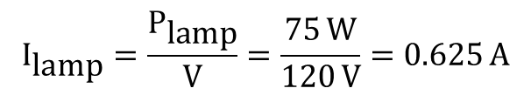
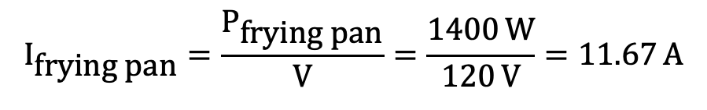
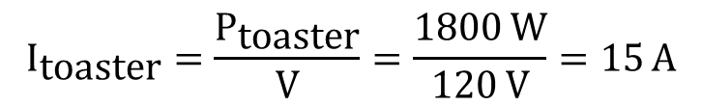
Question 4: ANSWERS
(a) What current is drawn by each device?
The current drawn by an electrical device can be calculated using the formula:
$$I=\frac{P}{V}$$
Given that the voltage for all devices is $V=120$V:
Current drawn by the toaster:
$$I_{\text{toaster}}=\frac{P_{\text{toaster}}}{V}=\frac{1800 \text{W}}{120 \text{V}}=15 \text{A}$$
Current drawn by the electric frying pan:
$$I_{\text{f}\text{rying} \text{pan}}=\frac{P_{\text{frying} \text{pan}}}{V}=\frac{1400 \text{W}}{120 \text{V}}=11.67 \text{A}$$
Current drawn by the lamp:
$$I_{\text{lamp}}=\frac{P_{\text{lamp}}}{V}=\frac{75 \text{W}}{120 \text{V}}=0.625 \text{A}$$

Slide 16

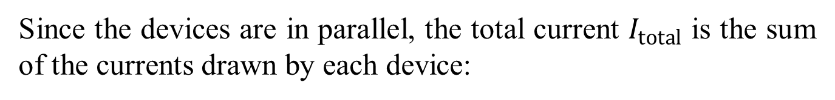
Question 4: ANSWERS
(b) Will this combination blow the 15 A fuse?
To determine if the fuse will blow, we need to calculate the total current drawn by all three devices when plugged into the same outlet.
Since the devices are in parallel, the total current $I_{total}$ is the sum of the currents drawn by each device:
$$I_{\text{total}}=I_{\text{toaster}}+I_{\text{frying} \text{pan}}+I_{\text{lamp}}$$
$$I_{\text{total}}=15 \text{A}+11.67 \text{A}+0.625 \text{A}=27.295 \text{A}$$
The total current drawn by the three devices is $27.295$A.
This current exceeds the 15 A fuse rating, so the combination will blow the 15 A fuse.

Slide 17
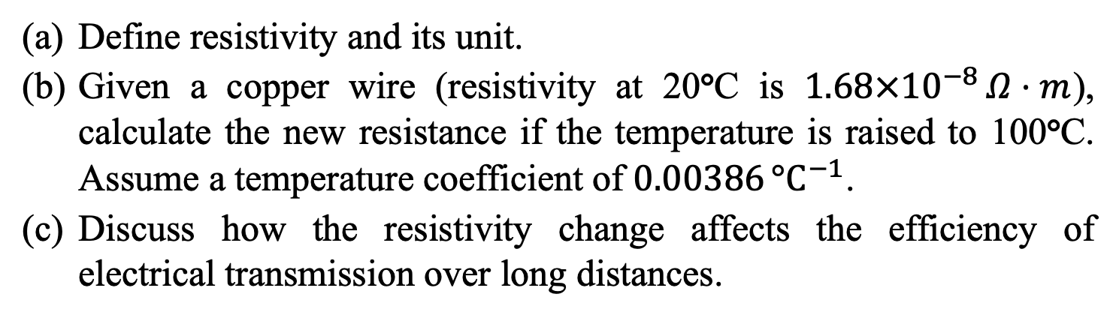
Question 5
Define resistivity and its unit.
Given a copper wire (resistivity at 20°C is $1.68×{10}^{−8} Ω⋅m$), calculate the new resistance if the temperature is raised to 100°C. Assume a temperature coefficient of $0.00386 {°C}^{−1}$.
Discuss how the resistivity change affects the efficiency of electrical transmission over long distances.

Slide 18
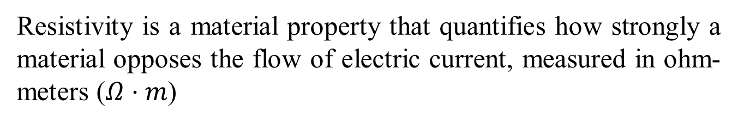
Question 5: ANSWERS
(a) Resistivity is a material
Resistivity is a material property that quantifies how strongly a material opposes the flow of electric current, measured in ohm-meters ($Ω⋅m$)
(b) New resistivity ρ
New resistivity $ρ=ρ_{0}\left(1+αΔT\right)$, where $ΔT=100−20=80$°C:
$$ρ=1.68×{10}^{−8}\left(1+0.00386×80\right)=2.10×{10}^{−8} Ω⋅m$$
(c) Resistivity increases
As resistivity increases with temperature, resistance also increases, reducing the efficiency of power transmission due to higher energy losses as heat.

Slide 19
Question 6
How much charge does a 12 V battery have to supply to fully charge 2.5 μF capacitor and a 5 μF capacitor when they are:
in parallel
in series
How much energy does the battery have to supply in each case?

Slide 20
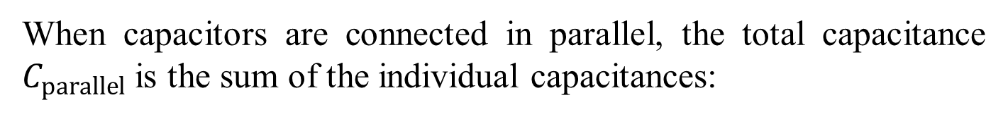
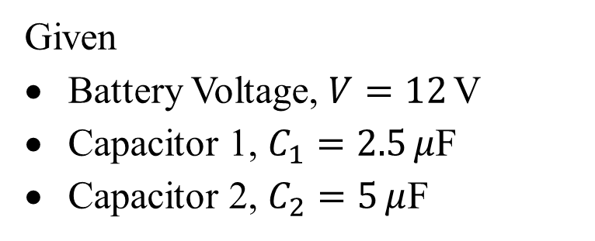

Question 6
Given
Battery Voltage, $V=12$V
Capacitor 1, $C_{1}=2.5 μ$F
Capacitor 2, $C_{2}=5 μ$F
(a) Capacitors in Parallel
When capacitors are connected in parallel, the total capacitance $C_{parallel}$ is the sum of the individual capacitances:
$$C_{\text{parallel}}=C_{1}+C_{2}=2.5 μ\text{F}+5 μ\text{F}=7.5 μ\text{F}$$
The charge $Q$ stored in the parallel combination is:
$$Q_{\text{parallel}}=C_{\text{parallel}}×V=7.5 μ\text{F}×12 \text{V}=90 μ\text{C}$$

Slide 21

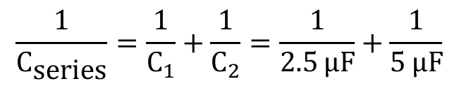
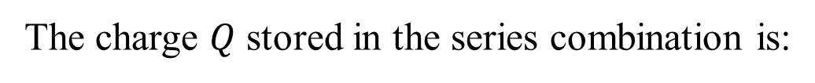
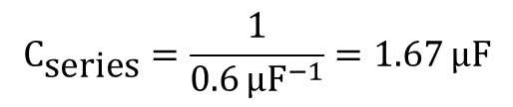
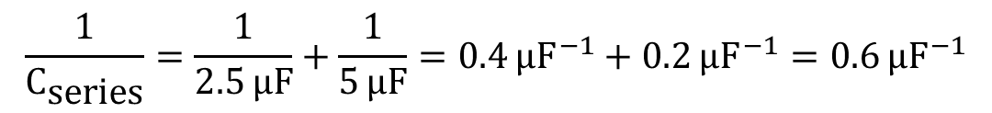
Question 6
(b) Capacitors in Series
$$\frac{1}{C_{\text{series}}}=\frac{1}{C_{1}}+\frac{1}{C_{2}}=\frac{1}{2.5 μ\text{F}}+\frac{1}{5 μ\text{F}}$$
Calculating $C_{series}$:
$$\frac{1}{C_{\text{series}}}=\frac{1}{2.5 μ\text{F}}+\frac{1}{5 μ\text{F}}=0.4 μ{\text{F}}^{−1}+0.2 μ{\text{F}}^{−1}=0.6 μ{\text{F}}^{−1}$$
$$C_{\text{series}}=\frac{1}{0.6 μ{\text{F}}^{−1}}=1.67 μ\text{F}$$
The charge $Q$ stored in the series combination is:
$$Q_{\text{series}}=C_{\text{series}}×V=1.67 μ\text{F}×12 \text{V}=20.04 μ\text{C}$$

Slide 22
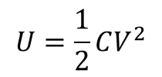

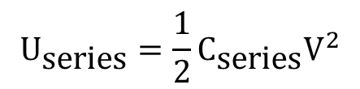
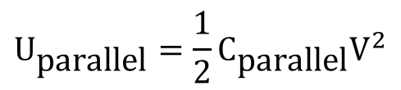
Question 6
(c) Energy Supplied by the Battery
The energy $U$ stored in a capacitor is given by:
$$U=\frac{1}{2}CV^{2}$$
For Parallel Combination:
$$U_{\text{parallel}}=\frac{1}{2}C_{\text{parallel}}V^{2}$$
$$U_{\text{parallel}}=\frac{1}{2}×7.5 μ\text{F}×{\left(12 \text{V}\right)}^{2}=\frac{1}{2}×7.5×144 μ\text{J}=540 μ\text{J}$$
For Series Combination:
$$U_{\text{series}}=\frac{1}{2}C_{\text{series}}V^{2}$$
$$U_{\text{series}}=\frac{1}{2}×1.67 μ\text{F}×{\left(12 \text{V}\right)}^{2}=\frac{1}{2}×1.67×144 μ\text{J}=120.24 μ\text{J}$$

Slide 23
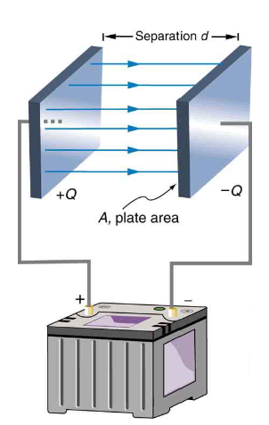
Question 7
A parallel-plate vacuum capacitor has 8.38 J of energy stored in it. The separation between the plates is 2.30 mm. If the separation is decreased to 1.15 mm, what is the energy stored?
if the capacitor is disconnected from the potential source so the charge on the plates remains constant, and
if the capacitor remains connected to the potential source so the potential difference between the plates remains constant

Slide 24

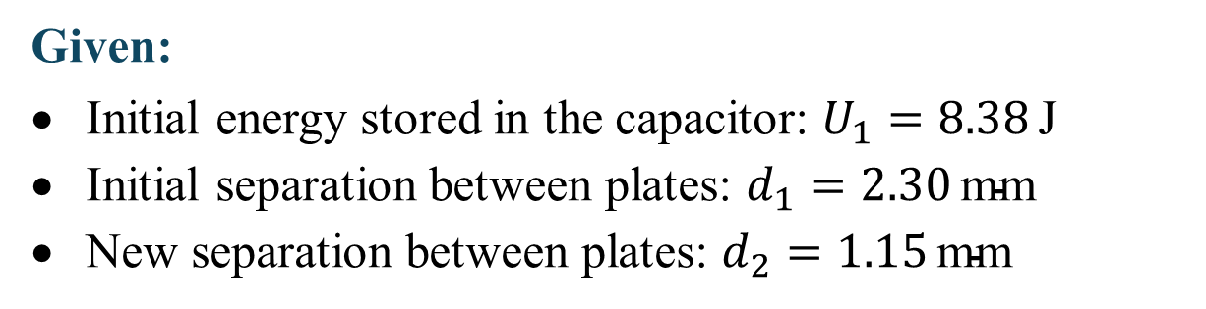
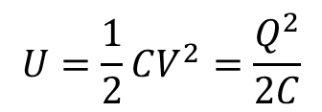
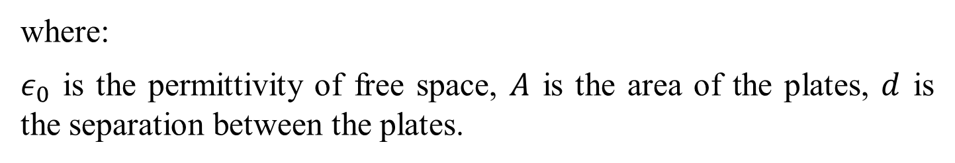
Question 7: ANSWERS
Given:
Initial energy stored in the capacitor: $U_{1}=8.38 \text{J}$
Initial separation between plates: $d_{1}=2.30 \text{mm}$
New separation between plates: $d_{2}=1.15 \text{mm}$
Capacitance of a parallel-plate capacitor:
$$C=\frac{ε_{0}A}{d}$$
where:
$ε_{0}$ is the permittivity of free space, $A$ is the area of the plates, $d$ is the separation between the plates.
Energy stored in a capacitor:
$$U=\frac{1}{2}CV^{2}=\frac{Q^{2}}{2C}$$

Slide 25
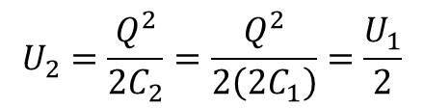
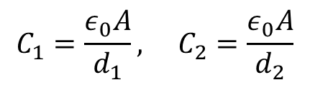
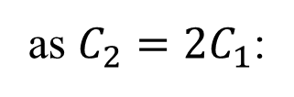
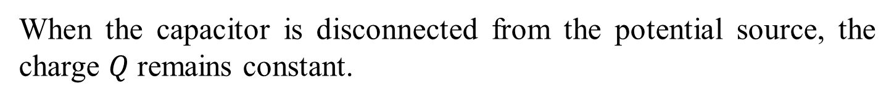
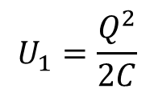

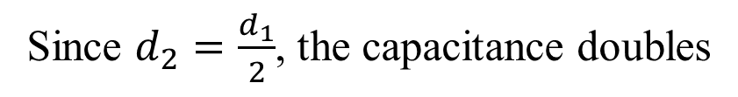
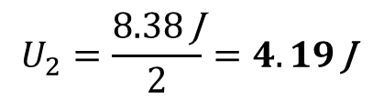
Question 7: ANSWERS
(a) Capacitor disconnected from the potential source (constant charge)
When the capacitor is disconnected from the potential source, the charge $Q$ remains constant.
The capacitance changes when the plate separation changes
$$C_{1}=\frac{ε_{0}A}{d_{1}}, C_{2}=\frac{ε_{0}A}{d_{2}}$$
Since $d_{2}=\frac{d_{1}}{2}$, the capacitance doubles
$$C_{2}=2C_{1}$$
The energy stored in the capacitor is given by
$$U_{1}=\frac{Q^{2}}{2C}$$
as $C_{2}=2C_{1}$:
$$U_{2}=\frac{Q^{2}}{2C_{2}}=\frac{Q^{2}}{2\left(2C_{1}\right)}=\frac{U_{1}}{2}$$
Thus, the new energy stored is:
$$U_{2}=\frac{8.38 \text{J}}{2}=4.19 \text{J}$$

Slide 26
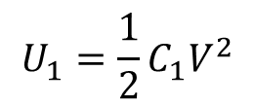

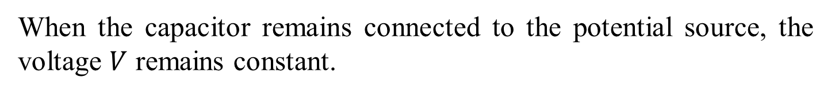
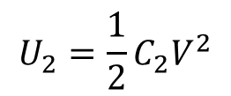
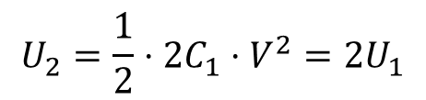
Question 7: ANSWERS
(b) Capacitor remains connected to the potential source
When the capacitor remains connected to the potential source, the voltage $V$ remains constant.
The energy stored in the capacitor is given by:
$$U_{1}=\frac{1}{2}C_{1}V^{2}$$
Since $C_{2}=2C_{1}$, the energy stored in the capacitor becomes:
$$U_{2}=\frac{1}{2}C_{2}V^{2}$$
$$U_{2}=\frac{1}{2}⋅2C_{1}⋅V^{2}=2U_{1}$$
Thus, the new energy stored is:
$$U_{2}=2×8.38 \text{J}=16.76 \text{J}$$

Slide 27
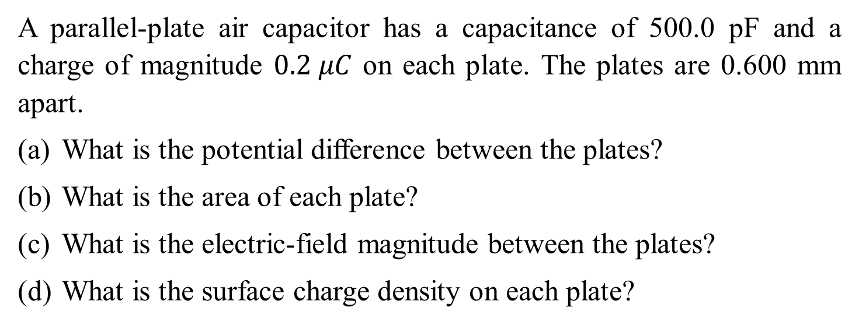
Question 8
A parallel-plate air capacitor has a capacitance of 500.0 pF and a charge of magnitude $0.2 μC$ on each plate. The plates are 0.600 mm apart.
What is the potential difference between the plates?
What is the area of each plate?
What is the electric-field magnitude between the plates?
What is the surface charge density on each plate?

Slide 28
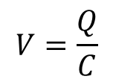



Question 8: ANSWERS
Given
Capacitance, $C=500.0 pF=500.0×{10}^{−12}$F
Charge, $Q=0.2 μC=0.2×{10}^{−6}$C
Separation between the plates, $d=0.60 mm=0.60×{10}^{−3}$m
(a) Potential Difference between the Plates
The potential difference V between the plates of a capacitor can be found using the formula:
$$V=\frac{Q}{C}$$
Substitute the given values:
$$V=\frac{0.2×{10}^{−6} \text{C}}{500.0×{10}^{−12} \text{F}}$$
$$V=400 \text{V}$$
So, the potential difference between the plates is 400 V.

Slide 29






Question 8: ANSWERS
(b) Area of Each Plate
The capacitance C of a parallel-plate capacitor is given by:
$$C=\frac{ε_{0}A}{d}$$
where:
$ε_{0}$ is the permittivity of free space, $ε_{0}=8.854×{10}^{−12}$F/m,
$A$ is the area of each plate.
Rearrange the formula to solve for $A$:
$$A=\frac{C⋅d}{ε_{0}}$$
Substitute the known values:
$$A=\frac{500.0×{10}^{−12} \text{F}×0.600×{10}^{−3} \text{m}}{8.854×{10}^{−12} \text{F}\text{/}\text{m}}$$
$$A≈0.03387 {\text{m}}^{2}$$
So, the area of each plate is approximately 0.0339 m².

Slide 30








Question 8: ANSWERS
(c) Electric-Field Magnitude between the Plates
The electric field $E$ between the plates of a parallel-plate capacitor is given by:
$$E=\frac{V}{d}$$
$$E=\frac{400 \text{V}}{0.600×{10}^{−3} \text{m}}$$
Substitute the known values:
$$E=6.67×{10}^{5} \text{V}\text{/}\text{m}$$
So, the electric field magnitude between the plates is 6.67 × 10⁵ V/m.
(d) Surface Charge Density on Each Plate
The surface charge density $σ$ is given by:
$$σ=\frac{Q}{A}$$
$$σ=\frac{0.2×{10}^{−6} \text{C}}{0.03387 {\text{m}}^{2}}$$
$$σ=5.90×{10}^{−6} {\text{C}\text{/}\text{m}}^{2}$$
So, the surface charge density on each plate is approximately 5.90 × 10⁻⁶ C/m²

Slide 31
Q&A? Office hours:

Slide 32


Question 9-Extension
What is the capacitance per unit length ($F/m$) of a coaxial cable whose inner conductor has a 1.0 mm diameter, and the outer cylindrical sheath has a 5.0 mm diameter? Assume the space between is filled with air.

Slide 33










Question 9: ANSWERS
$$C=\frac{Q}{V}$$
$$ρ=\frac{Q}{L}→Q=ρL$$
$$C=\frac{ρL}{V}$$
$$\frac{C}{L}=\frac{ρ}{V} \left(F/m\right)$$
Consider a coaxial cable of inner radius ’a’ and outer radius ‘b’.
The two cylinders are charge at a rate of ‘$ρl$’ (line charge density)
The electric field intensity at any distance ‘r’ between ‘a’ and ‘b’
$$φ=\oint{EdA}=\frac{ρ}{ε_{0}}→EA=\frac{ρ}{ε_{0}}→E\left(2πrL\right)=\frac{ρ}{ε_{0}}→E=\frac{ρ}{{2πrLε}_{0}}$$
The potential difference between the cylinders
$$V=−\int_{b}^{a}{Edr} →V=−\int_{b}^{a}{\frac{1}{2πε_{0}L}\frac{ρL}{r} dr=−\frac{ρ}{2πε_{0}}\int_{b}^{a}{\frac{1}{r} dr}}$$
$$V=−\frac{ρ}{2πε_{0}} \left[ln\left|r\right|{a \atop b}\right]→$$
$$V=−\frac{ρ}{2πε_{0}} \left[ln\left(a\right)−ln\left(b\right)\right]→$$
$$V=\frac{ρ}{2πε_{0}} \left[ln\left(b\right)−ln\left(a\right)\right]$$

Slide 34









Question 9: ANSWERS
$$V=−\frac{ρ}{2πε_{0}} \left[ln\left|r\right|{a \atop b}\right]→$$
$$V=−\frac{ρ}{2πε_{0}} \left[ln\left(a\right)−ln\left(b\right)\right]→$$
$$V=\frac{ρ}{2πε_{0}} \left[ln\left(b\right)−ln\left(a\right)\right]$$
$$V=\frac{ρ}{2πε_{0}}ln\left(b/a\right)$$
$$C=\frac{ρL}{V}→$$
$$\frac{C}{L}=\frac{ρ}{V}$$
$$\frac{C}{L}=\frac{ρ}{\frac{ρ}{2πε_{0}}ln\left(b/a\right)}→$$
$$C=\frac{2πε_{0}}{ln\left(b/a\right)}$$
$$C=\frac{2π\left({8.85×10}^{−12}\right)}{ln\left({2.5 mm}/{0.5 mm}\right)}={3.5×10}^{−11}F/m$$

Slide 35

Question 10-Extension
A large metal sheet of thickness 𝑙 is placed between, and parallel to, the plates of the parallel-plate capacitor as shown in the figure below. It does not touch the plates, and extends beyond their edges.
What is now the net capacitance in terms of 𝐴, 𝑑, and 𝑙?
If 𝑙 = 0.40𝑑, by what factor does the capacitance change when the sheet is inserted?

Slide 36








Question 10: ANSWERS
(a) net capacitance in terms of 𝐴, 𝑑, and l
$$E=\frac{σ}{ε_{0}}=\frac{Q}{Aε_{0}}=\frac{V_{n}}{r}→Er=\frac{Qr}{Aε_{0}}=V_{n}$$
$$V_{n}=\frac{Qr}{Aε_{0}}$$
$$V_{1}=\frac{Qx}{Aε_{0}}$$
$$V_{2}=\frac{Q\left(d−x−l\right)}{Aε_{0}}$$
$$∆V=V_{1}+V_{2}=\frac{Qx}{Aε_{0}}+\frac{Q\left(d−x−l\right)}{Aε_{0}}=\frac{Q\left(d−l\right)}{Aε_{0}}=\frac{Q}{C}→C=\frac{Aε_{0}}{\left(d−l\right)}$$
(b) what factor does the capacitance change when the sheet is inserted
$$\frac{C_{final}}{C_{initial}}=\frac{\frac{Aε_{0}}{\left(d−l\right)}}{\frac{Aε_{0}}{\left(d\right)}}$$
$$C_{initial}=\frac{Aε_{0}}{\left(d\right)}$$
$$C_{final}=\frac{Aε_{0}}{\left(d−l\right)}$$
$$\frac{C_{final}}{C_{initial}}=\frac{\left(d\right)}{\left(d−l\right)}=\frac{d}{d−0.40d}=\frac{1}{0.60}=1.7$$

Slide 37


Question 11-Extension
Three conducting plates, each of area 𝐴, are connected as shown in the figure below.
Are the two capacitors thus formed connected in series or in parallel?
Determine capacitance, C, as a function of $d_{1}$, $d_{2}$, and $A$. Assume $d_{1}$ $+$ $d_{2}$ is much less than the dimensions of the plates.
The middle plate can be moved (changing the values of $d_{1}$ and $d_{2}$), to vary the capacitance of the system. What are the minimum and maximum values of the net capacitance?

Slide 38

Question 11: ANSWERS
(a) Are the two capacitors thus formed connected in series or in parallel
Both capacitors have their high voltage plates at the same potential (the middle plate), and both capacitors have their low voltage plates at the same potential (the outer plates, which are connected). The two capacitors are in parallel .
(b) Determine capacitance, C, as a function of $d_{1}$, $d_{2}$, and $A$
$$C=C_{1}+C_{2}=\frac{ε_{0}A}{d_{1}}+\frac{ε_{0}A}{d_{2}}=ε_{0}A\left(\frac{1}{d_{1}}+\frac{1}{d_{2}}\right)=ε_{0}A\left(\frac{d_{1}+d_{2}}{d_{1}d_{2}}\right)$$

Slide 39




Question 11: ANSWERS
(c) minimum and maximum values of the net capacitance
Let $l=d_{1}+ d_{2}=$ constant. Then $C=\frac{ε_{0}Al}{d_{1}d_{2}}=\frac{ε_{0}Al}{d_{1}\left(l−d_{1}\right)}$
For the Max: We see that $C→∞$as $d_{1}→0$ or $d_{1}→l \text{(}\text{which} \text{is} d_{2}→0\text{)}$
Of course, a real capacitor would break down as the plates get too close to each other.
To find the minimum capacitance, set $\frac{dC}{d\left(d_{1}\right)}=0 and solve for d_{1}.$
$$\frac{dC}{d\left(d_{1}\right)}=\frac{d}{d\left(d_{1}\right)}\left[\frac{ε_{0}Al}{d_{1}\left(l−d_{1}\right)}\right]=\left[ε_{0}Al{\left(d_{1}l−{d_{1}}^{2}\right)}^{−2}\left(l−2d_{1}\right)\right]=0$$
$$ε_{0}Al\frac{\left(l−2d_{1}\right)}{{\left(d_{1}l−{d_{1}}^{2}\right)}^{2}}=0→d_{1}=\frac{1}{2}l=d_{2}$$
$${C_{min}=ε}_{0}A\left(\frac{d_{1}+d_{2}}{d_{1}d_{2}}\right)=ε_{0}A\left(\frac{l}{\left(\frac{1}{2}l\right)\left(\frac{1}{2}l\right)}\right)=ε_{0}A\frac{4}{l}→C_{min}=\frac{4ε_{0}A}{d_{1}+d_{2}}; C_{max}=∞$$

